Slide 1
Home Loan Prediction using Machine Learning
By:- Arundhati Ghanade

Slide 2
Content
Introduction
The classification problem
Steps involved in machine learning
Features
Labels
Visualizing data using Google Colab
Explanation of the Code using Google Colab
Models of training and testing the dataset
Loan prediction using logistic regression
Loan prediction using random forest classification
Loan prediction using decision tree classification
Loan Prediction models Comparison

Slide 3
INTRODUCTION
Loan-Prediction
Understanding the problem statement is the first and foremost step. This would help you give an intuition of what you will face ahead of time. Let us see the problem statement.
Dream Housing Finance company deals in all home loans. They have presence across all urban, semi urban and rural areas. Customer first apply for home loan after that company validates the customer eligibility for loan. Company wants to automate the loan eligibility process (real time) based on customer detail provided while filling online application form. These details are Gender, Marital Status, Education, Number of Dependents, Income, Loan Amount, Credit History and others. To automate this process, they have given a problem to identify the customers segments, those are eligible for loan amount so that they can specifically target these customers.

Slide 4
The Classification problem
It is a classification problem where we have to predict whether a loan would be approved or not. In a classification problem, we have to predict discrete values based on a given set of independent variable(s). Classification can be of two types:
Binary Classification : In this classification we have to predict either of the two given classes. For example: classifying the gender as male or female, predicting the result as win or loss, etc. Multiclass Classification : Here we have to classify the data into three or more classes. For example: classifying a movie's genre as comedy, action or romantic, classify fruits as oranges, apples, or pears, etc.
Loan prediction is a very common real-life problem that each retail bank faces atleast once in its lifetime. If done correctly, it can save a lot of man hours at the end of a retail bank.

Slide 5
Steps involved in machine learning
1 - Data Collection
The quantity & quality of your data dictate how accurate our model is
The outcome of this step is generally a representation of data (Guo simplifies to specifying a table) which we will use for training
Using pre-collected data, by way of datasets from Kaggle, UCI, etc., still fits into this step
2 - Data Preparation
Wrangle data and prepare it for training
Clean that which may require it (remove duplicates, correct errors, deal with missing values, normalization, data type conversions, etc.)
Randomize data, which erases the effects of the particular order in which we collected and/or otherwise prepared our data.

Slide 6
Steps involved in machine learning
3 - Choose a Model
Different algorithms are for different tasks; choose the right one
4 - Train the Model
The goal of training is to answer a question or make a prediction correctly as often as possible
Linear regression example: algorithm would need to learn values for m (or W) and b (x is input, y is output)
Each iteration of process is a training step

Slide 7
Steps involved in machine learning
5 - Evaluate the Model
Uses some metric or combination of metrics to "measure" objective performance of model
Test the model against previously unseen data
This unseen data is meant to be somewhat representative of model performance in the real world, but still helps tune the model (as opposed to test data, which does not)
Good train/evaluate split 80/20, 70/30, or similar, depending on domain, data availability, dataset particulars, etc.

Slide 8
Steps involved in machine learning
6 - Parameter Tuning
This step refers to hyper-parameter tuning, which is an "art form" as opposed to a science
Tune model parameters for improved performance
Simple model hyper-parameters may include: number of training steps, learning rate, initialization values and distribution, etc.
7 - Make Predictions
Using further (test set) data which have, until this point, been withheld from the model (and for which class labels are known), are used to test the model; a better approximation of how the model will perform in the real world.

Slide 9
DATASETS
Here we have two datasets. First is train_dataset.csv, test_dataset.csv.
These are datasets of loan approval applications which are featured with annual income, married or not, dependents are there or not, educated or not, credit history present or not, loan amount etc.
The outcome of the dataset is represented by loan status in the train dataset.
This column is absent in test_dataset.csv as we need to assign loan status with the help of training dataset.

Slide 10
FEATURES PRESENT IN LOAN PREDICTION
Loan_ID – The ID number generated by the bank which is giving loan.
Gender – Whether the person taking loan is male or female.
Married – Whether the person is married or unmarried.
Dependents – Family members who stay with the person.
Education – Educational qualification of the person taking loan.
Self_Employed – Whether the person is self-employed or not.
ApplicantIncome – The basic salary or income of the applicant per month.
CoapplicantIncome – The basic income or family members.
LoanAmount – The amount of loan for which loan is applied.
Loan_Amount_Term – How much time does the loan applicant take to pay the loan.
Credit_History – Whether the loan applicant has taken loan previously from same bank.
Property_Area – This is about the area where the person stays ( Rural/Urban).

Slide 11
Labels
LOAN_STATUS – Based on the mentioned features, the machine learning algorithm decides whether the person should be give loan or not.

Slide 12
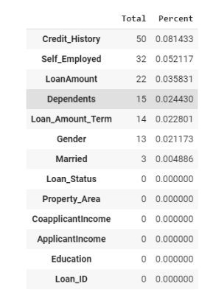
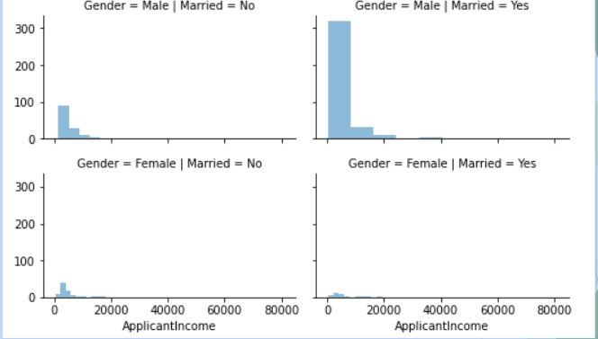
Visualizing data using google Colab

Slide 13
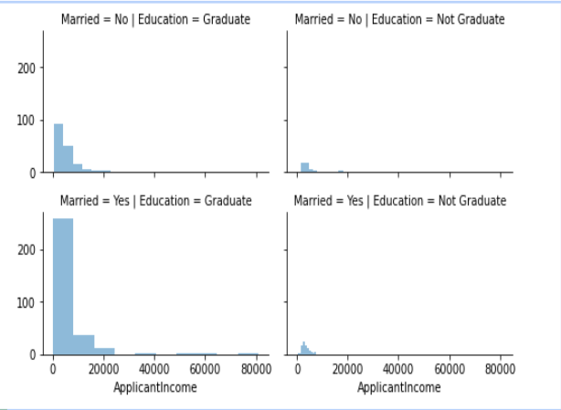
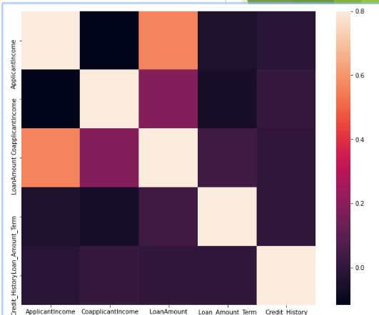
Visualizing data using google Colab

Slide 14
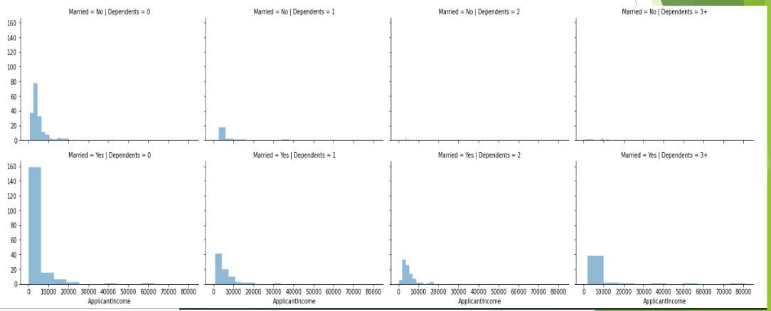
Visualizing data using google Colab

Slide 15
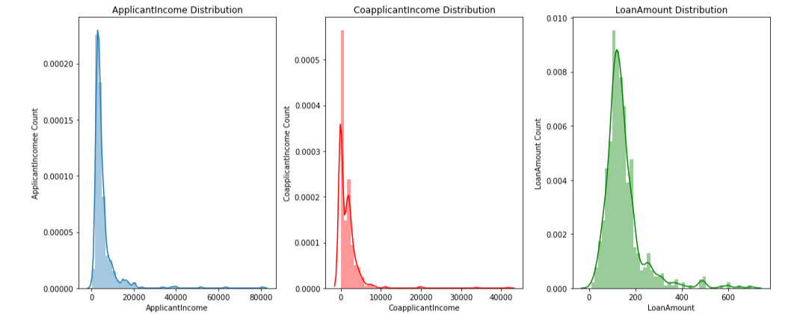
Visualizing data using google Colab

Slide 16
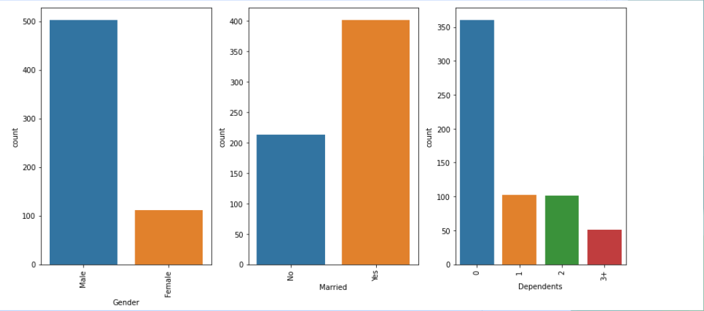
Visualizing data using google Colab

Slide 17
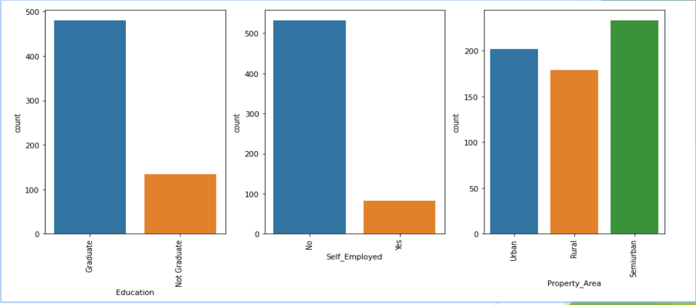
Visualizing data using google Colab

Slide 18
Explanation of the Code using Google Colab
The dataset is trained and tested with 3 methods
Loan prediction using logistic regression
Loan prediction using random forest classification
Loan prediction using decision tree classification

Slide 19
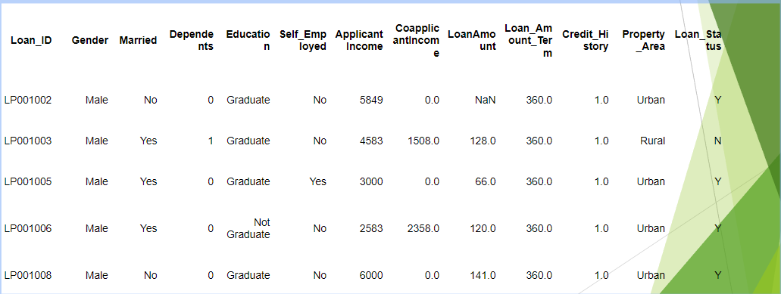
Loan prediction using Logistic Regression
# take a look at the top 5 rows of the train set, notice the column "Loan_Status"
train.head()

Slide 20
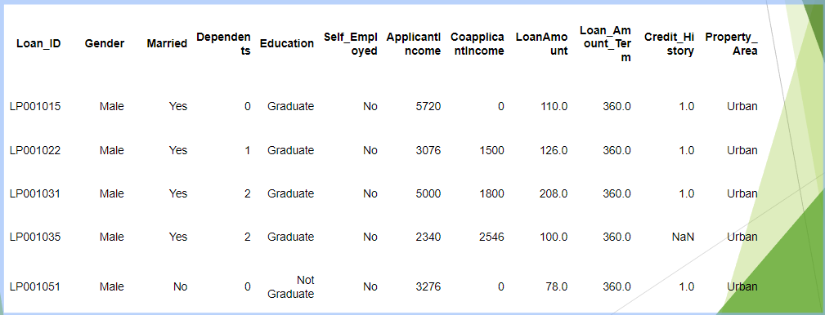
Loan prediction using Logistic Regression
# take a look at the top 5 rows of the test set, notice the absense of "Loan_Status" that we will predict
test.head()

Slide 21
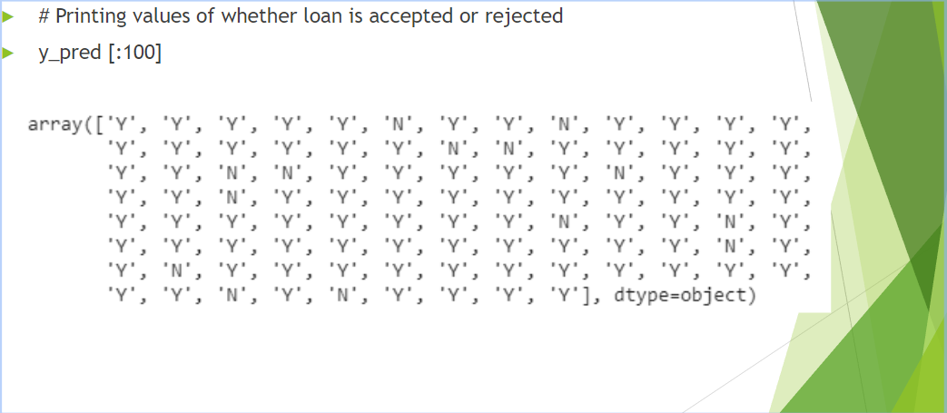
Loan prediction using Logistic Regression

Slide 22
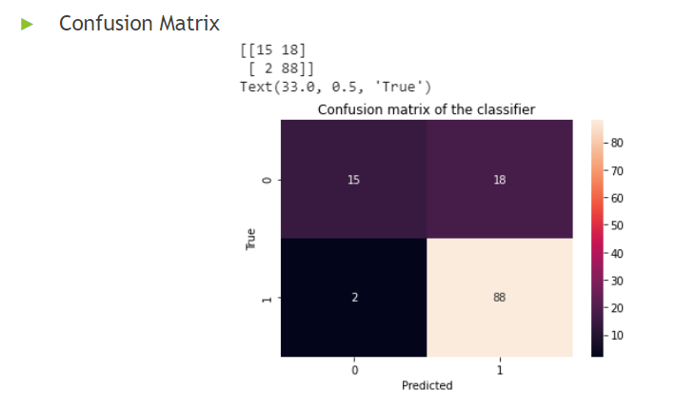
Loan prediction using Logistic Regression

Slide 23
Loan prediction using Logistic Regression
# Check Accuracy
from sklearn.metrics import accuracy_score
accuracy_score(y_test,y_pred)
0.8373983739837398
# Applying k-Fold Cross Validation
from sklearn.model_selection import cross_val_score
accuracies = cross_val_score(estimator = classifier, X = X_train, y = y_train, cv = 10)
accuracies.mean()
# accuracies.std()
0.8024081632653062

Slide 24
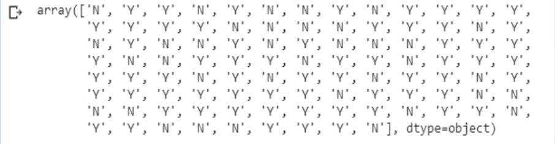
Loan prediction using random forest classification
# Printing values of whether loan is accepted or rejected
y_pred [:100]

Slide 25
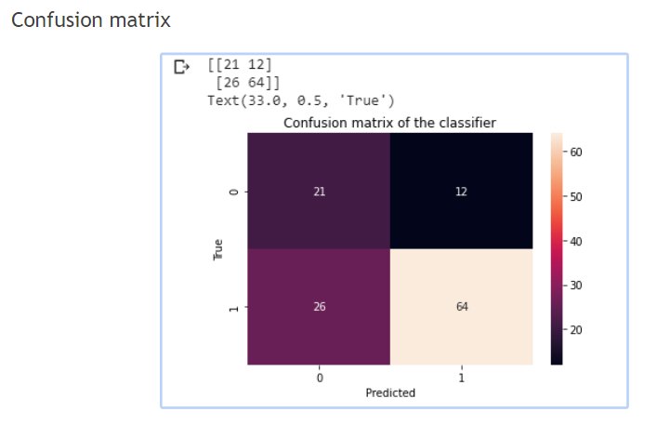
Loan prediction using random forest classification

Slide 26
Loan prediction using random forest classification
# Check Accuracy
from sklearn.metrics import accuracy_score
accuracy_score(y_test,y_pred)
0.6910569105691057
# Applying k-Fold Cross Validation
from sklearn.model_selection import cross_val_score
accuracies = cross_val_score(estimator = classifier, X = X_train, y = y_train, cv = 10)
accuracies.mean()
# accuracies.std()
0.7148163265306122
.

Slide 27
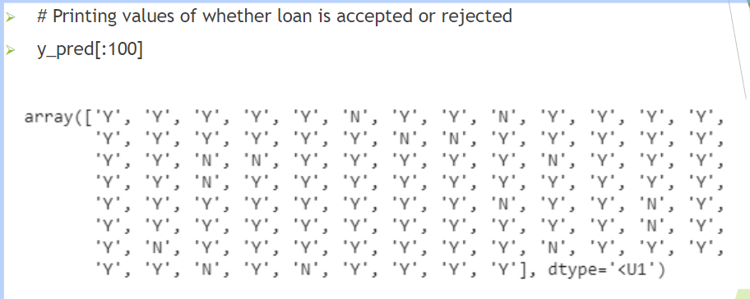
Loan Prediction using Decision Tree Classification

Slide 28
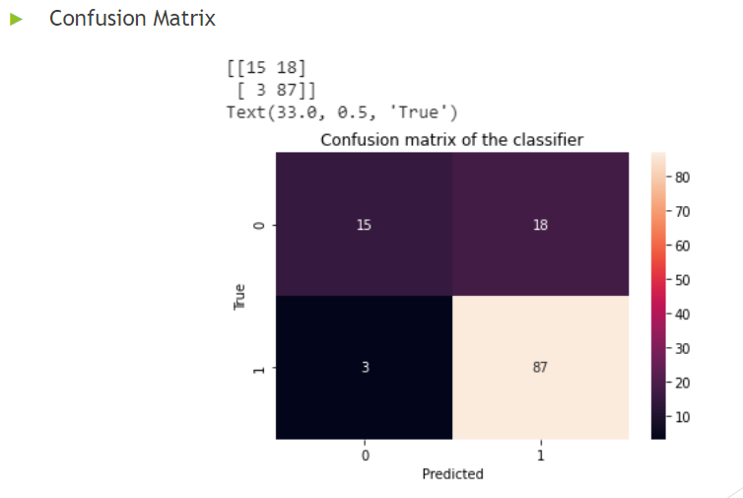
Loan Prediction using Decision Tree Classification

Slide 29
Loan Prediction using Decision Tree Classification
# Check Accuracy
from sklearn.metrics import accuracy_score
accuracy_score(y_test,y_pred)
0.8292682926829268
# Applying k-Fold Cross Validation
from sklearn.model_selection import cross_val_score
accuracies = cross_val_score(estimator = classifier, X = X_train, y = y_train, cv = 10)
accuracies.mean()
# accuracies.std()
0.7922448979591836

Slide 30
Loan prediction models comparison
Loan Prediction | Accuracy | Accuracy using K-fold Cross Validation
Using Logistic Regression | 0.8373983739837398 | 0.8024081632653062
Using Random Forest Classification | 0.6910569105691057 | 0.7148163265306122
Using Decision Tree Classification | 0.8292682926829268 | 0.7922448979591836
This means that from the above accuracy table, we can conclude that logistic regression is best model for the loan prediction problem.

Slide 31
Thank You
.

